Slide 1

Programming languages
Power of coding

Slide 2
Factors to Consider When Choosing Which Language to Learn
As we studied about programming language in the previous presentation. We have 700 programming languages in the world. And we listed 20 languages, now it is the time to select the best language among all.
So here we have few tips to follow while selecting the programming language
How Much Time Do You Have to Study?
What Employment Opportunities Are There?
Availability of Suitable Learning Resources
Personal Interest

Slide 3
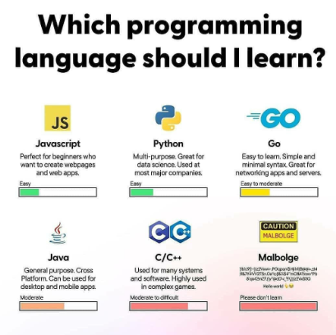
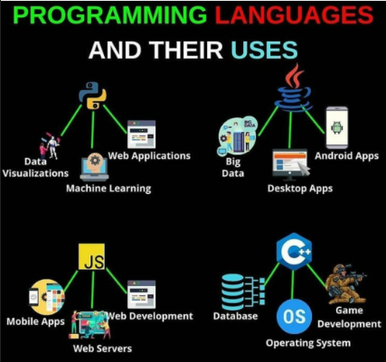
Factors to Consider When Choosing Which Language to Learn
According to the above tips we are choosing and learning Python

Slide 4
WHY PYTHON?
Five reasons to learn Python
1.Easy to learn – Simple syntaxes makes python easy to learn.
2.Popularity and demand – Very popular language in current times, because of multiple uses it is in high demand.
3.Libraries and frameworks – Extensive support of libraries and frameworks for various applications.
4.Large community group – Large online community of python users and experts to help new python programmers.
5.Scripting and automation – Python can be used as well as to automate different tasks.
Also we have the list of top companies using Python like – NOKIA, NASA, Dropbox, Amazon, Reddit, Facebook, YAHOO! Maps, Twitter, IBM, QUORA and Walt Disney(FEATURE ANIMATION)

Slide 5
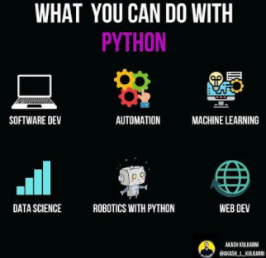
WHAT CAN PYTHON DO?
Here we have the list to know what can Python really do?
Web Development
Game development
Machine learning
Artificial intelligence
Data science
Data visualization
Desktop GUI
Web scraping application

Slide 6
Why PYTHON?
Let us compare Python with other languages like C, JAVA, C#, Ruby, Go and PHP.
PYTHON | C
Python is general purpose programming language. | C is mainly used for hardware related applications.
Python is interpreted. | C is compiled.
No need to declare a type of variable. | It is compulsory to declare the variable in C.
Python programs are easier to learn, write and read. | C program syntax is harder than python.
PYTHON | JAVA
Python is free and open source for all use cases. | Java is free and (mostly) open source except for corporate use.
Python is an interpreted language. | Java is a compiled language.
Python has 1 error type: traceback (or runtime) error. | Java has 2 types of errors: compile and runtime errors.
Any number of classes can exist in a single file in python. | Only one public top-level class can exist in a single file in java
Python involves writing fewer lines of code compared to java. | Java generally involves writing more lines of code compared to Python.

Slide 7
Why PYTHON?
PYTHON | C#
Open-source development and distribution, even for commercial use. | Developed by Microsoft. Comes with the license.
Supports multi-paradigm programming. | Based on OOP concepts.
Dynamic type-casting. No need foe variable. | Statically typed. The compiler will give errors for wrong typecasting.
Can be integrated with Java(JVM), .NET, C and JavaScript. | Supports works on .NET framework.
Simple, easy to read and code, doesn’t contain too many symbols or formats. | More organized and consistent syntax and format.
PYTHON | GO
Python paradigms are object-oriented, imperative, functional and procedural language. | Go paradigms are Procedural, functional and concurrent language.
Dynamically typed language. | Statistically typed language.
More focused on writing web applications. | More focused on being a system language.
Python is dynamically-typed, meaning that it checks for bugs at run-time. | Go web programming offers a smooth debugging process.
Python support inheritance. | Go doesn’t support inheritance.

Slide 8
Why PYTHON?
PYTHON | RUBY
Python is high-level programming language. | Ruby is a general purpose programming language.
Not fully object oriented programming language. | Fully object oriented programming language.
It will be present in the symbol table as long as it is in scope. | Once a variable is set you can’t unset it back.
Support multiple inheritance. It support tuples. | Supports single inheritance. It doesn’t support tuples.
PYTHON | PHP
Python has a smaller number of frameworks. | PHP users have access to mature frameworks.
Widely used in AI, data science and scientific community. | Language of choice for web development.
General purpose programming language. | Specialized for Web development programming language.
So finally decided to start learning PYTHON.

Slide 9

Every ending is a new Beginning   

